Slide 1
Service Fabric Patterns & Best Practices

Slide 2
Hyper-scale web
Todd Abel

Slide 3
“It depends…”
“And thirdly, the code is more what you'd call ‘guidelines’ than actual rules”
Captain Hector Barbosa – Pirates of the Caribbean: The Curse of the Black Pearl
Most of these are common sense
Always multiple ways to solve a problem
Each solution has pros and cons, knowing the
trade-offs is what is important
Fine to intentionally not follow a best practice

Slide 4
Debugging in Production
Typically don’t debug directly on production nodes
  Difficult to catch an issue directly
  Security and compliance concerns
  Should debug tools be installed on all production nodes?
Instrument your code
  Instrumenting your code is critical for debugging based on logs
  Should be able to trace the execution path through your code
  Always log in UTC
  Flow an activity id

Slide 5
Data Loss
Recovery Point Objective (RPO)
  How much data in minutes can the business afford to lose?
  Business should set the RPO, smaller RPO is more expensive
  Each service must expect and plan for data loss
Soft deletes (tombstoning) are best practice
  Hard delete later when you know it is not needed
Data Corruption
  Frequently caused by software bug (or a hacker)
  Detect corruption is a hard issue that is domain specific
  If needed, deal with corruption using journaling, snapshots/backups
  Make sure you test restoring from corruption

Slide 6

Availability and Reliability – Active/Passive
Two similar clusters
Only Cluster A takes traffic
Primary must handle spikes
Data replicated to cluster B in the background
Azure Traffic Manager
Cluster A (Primary)
Cluster B (Secondary)
Node
Node
Node
Node
Node
Node
Node
Node
Node
Node
Replication Traffic

Slide 7
Availability and Reliability – Active/Passive
Failover flow
  Customer experiences issue
  DevOps decides to fail over
  Data inconsistency/loss
    RPO == replication delay
  Takes minutes
Simple development
Infrequently tested
“Wasted” capacity
Azure Traffic Manager
Cluster A (Primary)
Cluster B (Secondary)
Node
Node
Node
Node
Node
Node
Node
Node
Node
Node
Replication Traffic

Slide 8
Availability and Reliability – Active/Active
Two similar clusters
Both clusters takes traffic
Both clusters handle spikes
  Less expensive
Data replicated to other cluster in the background
Azure Traffic Manager
Cluster A
Cluster B
Node
Node
Node
Node
Node
Node
Node
Node
Node
Node
Replication Traffic

Slide 9
Availability and Reliability – Active/Active
  Failover is fast and free
  Harder development
  Data inconsistency or
  dual reads
Continuously tested
Less “wasted” capacity
Azure Traffic Manager
Cluster A
Cluster B
Node
Node
Node
Node
Node
Node
Node
Node
Node
Node
Replication Traffic

Slide 10
Availability and Reliability – Real Example
Two regionally separated DCs
Can read from or write to either storage (RA-GRS), but default is local DC
Azure Traffic Manager
Azure Traffic Manager
Cluster B
Cluster A
Cluster B
Cluster A
Node
Node
Node
Node
Node
Node
Node
Node
Node
Node
Node
Node
Node
Node
Node
Node
Node
Node
Node
Node
Azure Storage A
(RA-GRS)
Azure Storage A
(RA-GRS)
Azure Storage B
(RA-GRS)
Azure Storage B
(RA-GRS)
Azure Storage B
(read only)
Azure Storage B
(read only)
Azure Storage A
(read only)
Azure Storage A
(read only)
Replication
East US
West US
East US
West US

Slide 11
Cascading Failures
One simple failure leads to system-wide failure
  Plan for failure and understand the impact of failure on the system and its SLA
  When a service fails, clients must retry continuously causing a traffic storm
  Can occur across regions, active-active cross region are not immune ¹
  Look at using Circuit Breaker patterns
    Retry using exponential back-off with a maximum interval
    Once connection is reestablished, reset the back-off interval
    https://msdn.microsoft.com/en-us/library/dn589784.aspx
  ¹ http://www.rightscale.com/blog/cloud-industry-insights/amazon-ec2-outage-summary-and-lessons-learned

Slide 12
Humans cause most Problems
Human error causes 60% to 80% of service outages ¹
Treat operational procedures like code
  Automate as much as feasible
  Manual procedures must be one-off processes
    Humans are slower than automation
    If you can document a manual procedure, why can’t it be automated?
  Validate and test automation
Automate certificate and key rotation
  Always have two certificates/keys and ensure that one is always valid
  Rotate regularly
  Caused Azure outage in 2013 ²
  ¹ http://www.facilitiesnet.com/datacenters/article/How-to-Minimize-Human-Error-Prevent-Data-Center-Downtime-Facilities-Management-Data-Centers-Feature-14223
  ² https://azure.microsoft.com/en-us/blog/windows-azure-service-disruption-from-expired-certificate

Slide 13
Service Granularity – A Goldilocks story
There is no clear rule that can be followed for all applications. Granularity of a service depends on the application usage patterns
Design for predominant read and write patterns
Consider replicating data within a service to accommodate conflicting patterns
Predominantly for stateful, but can affect stateless
Too fine grain
Excessive traffic
Multiple calls to assemble information
May replicate data to other services
Just Right
Traffic is balances
Entity size is “just right”
Services are authoritative
Too coarse grain
Service hotspots
More data than necessary is returned
May replicate data to other services

Slide 14
NOT Your Typical .NET Collections
.NET collections hold references
Reliable Collections hold objects (think database hand-offs)
  Misusing a reliable collection will corrupt your data!
Correct: Get reference, copy/change object, write new object
using (ITransaction tx = StateManager.CreateTransaction()) {
await m_dic.AddAsync(tx, name, user1);
user1.LastLogin = DateTime.UtcNow; // Corruption!
ConditionalResult<User> user2 = await m_dic.TryGetValueAsync(tx, name);
if (user2.HasValue) user2.Value.LastLogin = DateTime.UtcNow; // Corruption!
await tx.CommitAsync();
} // Of course, if you modify an object after CommitAsync, corruption!

Slide 15
Define Immutable Types to Force Correct Behavior
// If you don’t seal, derived classes must also be immutable
[DataContract]
public sealed class UserInfo
{
public UserInfo(Email email, IEnumerable<ItemId> itemsBidding = null)
{
// We can assign to the read-only properties only in the ctor
Email = email;
ItemsBidding = itemsBidding ?? new ItemId[0];
}
// Read-only properties (you can set default values):
[DataMember] public readonly Email Email; // Value type
[DataMember] public readonly IEnumerable<ItemId> ItemsBidding = null;
// "Modify" the object by creating a new one with the desired new state
public UserInfo AddItemBidding(ItemId itemId) =>
new UserInfo(Email, ItemsBidding.Concat(new[] { itemId }));
// Use UpdateWith to update a subset of values
public UserInfo UpdateWith(Email email)
{
return new UserInfo(email, ItemsBidding);
}
}
Read Jeffrey Richter’s article on collections
  https://azure.microsoft.com/en-us/documentation/articles/service-fabric-work-with-reliable-collections/#define-immutable-data-types-to-prevent-programmer-error

Slide 16
Idempotent Operations
Idempotence is the property of certain operations in mathematics and computer science, that can be applied multiple times without changing the result beyond the initial application
Retrying an operation is a critical pattern for services
Making an operation idempotent is easier than tracking duplicate requests
Idempotency with respect to HTTP verbs
  GET, HEAD, OPTIONS, TRACE should be idempotent (read only)
  POST is not idempotent, make it so using a two phase protocol
    POST to get a unique identifier for a resource and create a provisional item
    PUT to make the item permanent
    Background process to remove older provisional items
  PUT, DELETE are defined as idempotent
  PATCH is not defined as idempotent, but can be used that way. Please do so.

Slide 17
Optimizing Collection Performance
Read: https://azure.microsoft.com/en-us/documentation/articles/service-fabric-reliable-services-reliable-collections/
Minimize duration of a transaction
Dictionary Count: enumerates all items
Queue locking: enqueue/dequeue operations lock the entire queue
Use a custom serializer
Smaller data is better than bigger data
  Multiple transactions with smaller data may perform better than a single transaction with a single large item

Slide 18
Partitioning
Cluster A – 5 nodes and 20 Partitions
P1, P6, P11, P16
Read the article
  https://azure.microsoft.com/documentation/articles/service-fabric-concepts-partitioning/
Remember: A named service’s partitioning cannot be changed
Choose as many partitions as you will end up needing in the future
Keep related data within the same partition
10’s, 100’s or 1,000’s of partitions are OK
Consider independent scale units
  Are regional scale units required?
  Can a tenant’s data be split across multiple scale units?
  What is the minimum capacity needed for a single scale unit?
  How many partitions per scale unit?
P5, P10, P15, P20
P2, P7, P12, P17
P4, P9, P14, P19
P3, P8, P13, P18
Cluster A – 8 nodes and 20 Partitions
P1, P9
P8, P16
P2, P10
P7, P15
P3, P11
P6, P14
P4, P12
P5, P13

Slide 19
Beware of GetHashCode
Don’t use the result of the native GetHashCode as a partition key. The .Net documentation states
The hash code itself is not guaranteed to be stable. Hash codes for identical strings states can differ across versions of the .NET Framework and across platforms (such as 32-bit and 64-bit) for a single version of the .NET Framework. In some cases, they can even differ by application domain
If the hash changes, your data will not be retrievable
Override to use

Slide 20
Retrying Operations
Important to retying operations
  Initial retry should be quick
  Subsequent retries should not overly impact your service. Don’t DDOS yourself
Exponential back off
Circuit Breaker pattern
  Very good, but consider where to use
  Exponential back off, continuous retry until success
  https://msdn.microsoft.com/en-us/library/dn589784.aspx
Consider startup
  Don’t want to order service start up
  https://aws.amazon.com/message/67457/ see section on Elastic Load Balancing

Slide 21
Monitoring and Diagnostics

Slide 22
Service Fabric Generated Logs
Service Fabric logs
Required for support
Not useful for your diagnostics
Service Fabric Diagnostic Events
Reliable Actor https://azure.microsoft.com/en-us/documentation/articles/service-fabric-reliable-actors-diagnostics/
Reliable Services https://azure.microsoft.com/en-us/documentation/articles/service-fabric-reliable-services-diagnostics/
Operational Events

Slide 23
Cluster Management
Azure Monitoring
  Free offering integrated with the Azure portal
  Shows resource usage by node type (VMSS)
  https://azure.microsoft.com/en-us/blog/announcing-the-public-preview-of-azure-monitor/
OMS (Log Analytics)
  Builds on Azure Monitoring
  https://azure.microsoft.com/en-us/documentation/articles/log-analytics-service-fabric/

Slide 24
Application Instrumentation - EventSource
EventSource as Structured Events
Use for high performance low latency
Create events that fit specific situations e.g. start/stop, specific business requirements created order, created entry, updated entry
EventSource as Generic Events
Use for high performance low latency
Generic categories e.g. Debug, Trace, Error, Warning…

Slide 25
Structured Logging
Use when performance requirements are not as demanding
Represents logged data a structure that can be more easily searched
.Net Core logging
  Useful not just in .NET Core
  Leverages ILogger interface
  Plug in other providers
    Loggr - http://loggr.net/
    Nlog - http://nlog-project.org/
    Serilog - https://serilog.net/

Slide 26
Move Events off the node
WAD / LAD
Standard mechanism used to move events, log and counters
Uses agent configured on the node. Configure using ARM
  https://azure.microsoft.com/en-us/documentation/articles/service-fabric-diagnostics-how-to-setup-wad/
ELK Stack
Moves events directly to Elastic Search
  https://azure.microsoft.com/en-us/documentation/articles/service-fabric-diagnostic-how-to-use-elasticsearch/
EventFlow
Currently in preview, looking for feedback and PRs
Moves events directly to multiple outputs (AI, EventHub, ELK, console)
Allows local filtering
Configuration travels with service
  https://www.nuget.org/packages/Microsoft.Diagnostics.EventFlow/1.0.0-preview
  https://github.com/Azure/diagnostics-eventflow

Slide 27
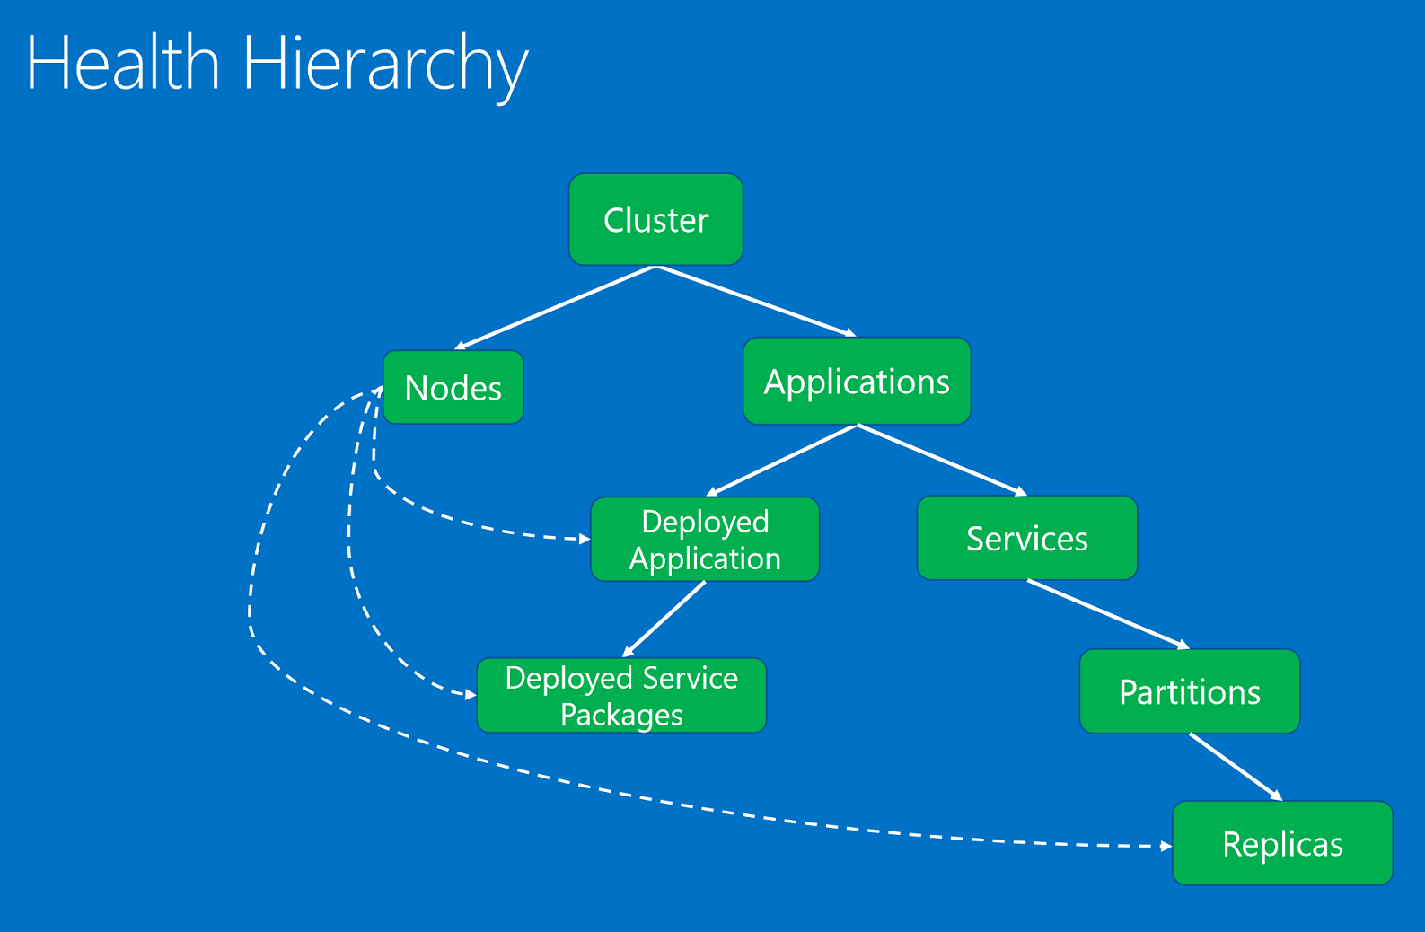
Critical for deployment and rollback
Think about having majority of verification checked done using health
https://azure.microsoft.com/en-us/documentation/articles/service-fabric-diagnostics-how-to-report-and-check-service-health/
https://azure.microsoft.com/en-us/documentation/articles/service-fabric-report-health/
https://azure.microsoft.com/en-us/documentation/articles/service-fabric-view-entities-aggregated-health/

Slide 28
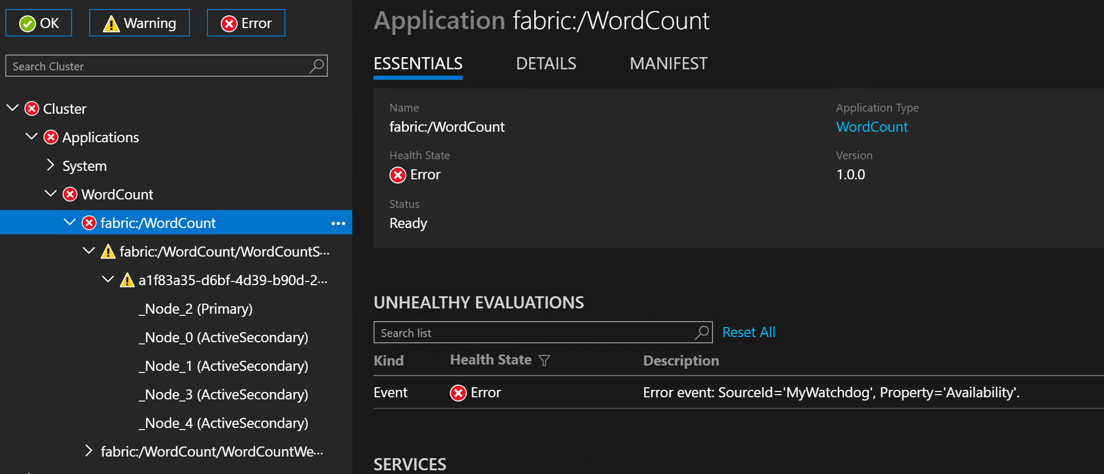
Health in Service Fabric Explorer

Slide 29
Metrics
Please report metrics that are relevant to your service
Viewable in SFX
Can be queried to build your own dashboard
Will start being sent via health and metric channel in next release
Can be used for balancing
https://azure.microsoft.com/en-us/documentation/articles/service-fabric-cluster-resource-manager-metrics/

Slide 30
Watchdog Service
Incorporate knowledge gained while operating service
Watches across services
Can run functional level tests
Can watch random traffic
Can help with auto scale

Slide 31
Configuration
Configuration is code - treat it like code
Don’t have a central configuration service
  Code and configuration should be versioned together. Not doing so creates an ordering for deployment
  Configuration, like code, should be immutable and follow the same lifecycle
  Issues with accessing remote store can cause your service to fail
  Changes are global
  Typical to poll for changes which adds additional requests and latency
  May have to handle multiple writers changing configuration
Service Fabric configuration can help, but
  Individual key-value pairs are too fine grained, wrap in class
  Difficult to validate that configuration is valid. Wrapped configuration can be validated

Slide 32
Versioning Code and Data
Why do we need this, it’s complex and hard
  Service aren’t independent if they break due to changes in other services
  Without versioning you have to coordinate with all dependencies when releasing
Do
  Add version to all requests and stored data
  You cannot add/remove property, change an API signature or behavior (e.g. enumerations) without incrementing the version
  Stateful services must be able to read all previous versions
  Do use a serialization framework that versions
    Avro - https://avro.apache.org/
    Bond - https://github.com/Microsoft/bond
    ProtoBuf - https://developers.google.com/protocol-buffers/

Slide 33
Application Upgrades
Clients calls must continue to succeed
  No control of when clients are upgraded vs. service interfaces
  Support multiple versions of clients
  Negotiate client version and disallow incompatible clients
Service Fabric upgrades by upgrade domain
  v.Next of the service must be backwards compatible for APIs and data
  Don’t expose types outside a service
  Two phase upgrade
    Upgrade code first, telling new code to behave exactly like old code
    Deploy new configuration allowing new code to behave like new version
      Front end nodes must wait for configuration
      Other nodes can assume new configuration has been deployed when they receive a new request

